Slide 1
Goodfellas
IS436 - 03
PAUL, BENJAMIN,DENSU, JAS, NIELS, TANNER, WILL, ZACH

Slide 2
User Interface Design, Program design and System Implementation
Deliverable 5
05-09-2019

Slide 3
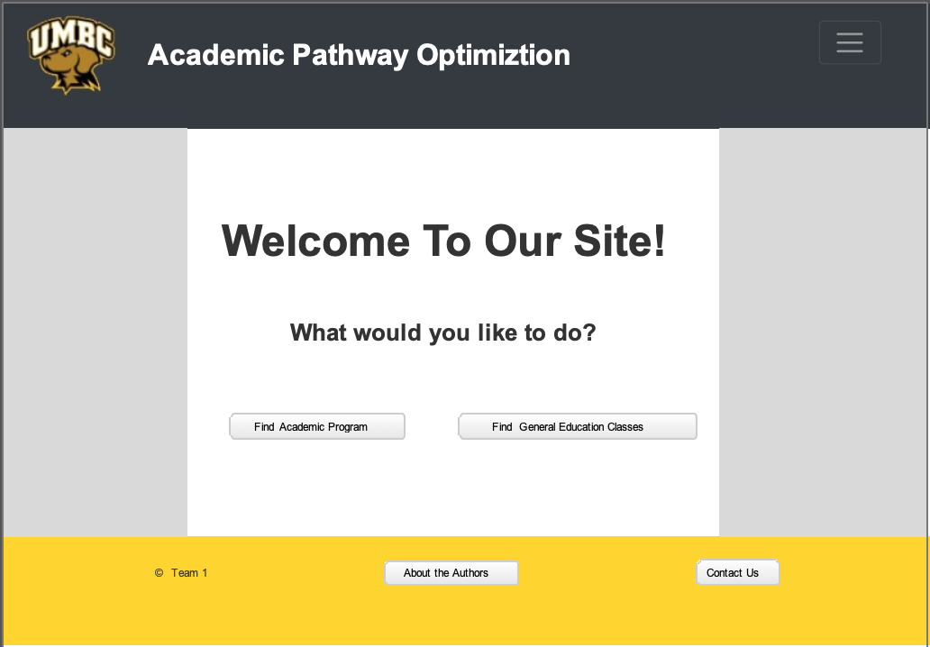
User Interface Design - Prototype: Homepage

Slide 4
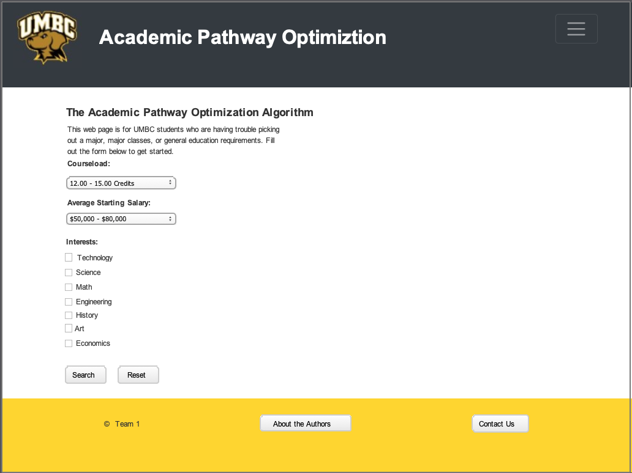
Prototype: Search (Academic Programs)

Slide 5
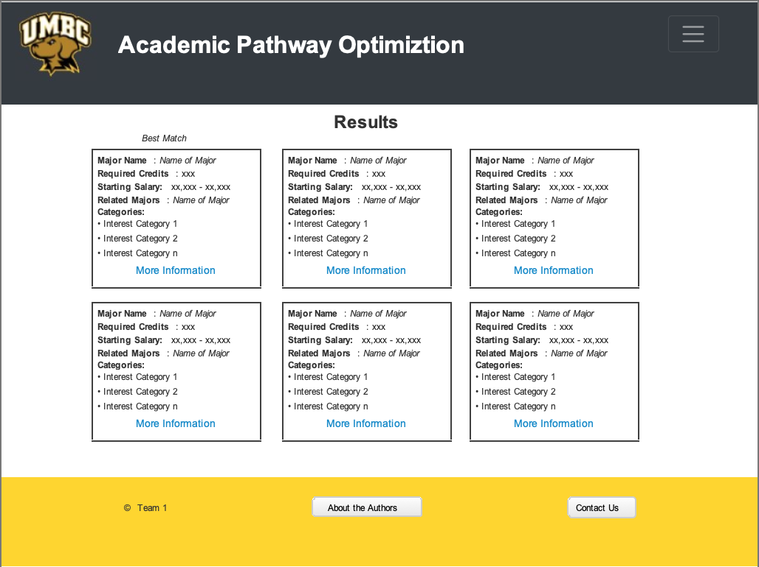
Prototype: Search Results

Slide 6




Program Design
Django v1.11 (latest LTR)
Security support
Developer support
SQLite
Lightweight relational database
Perfect for medium-small scale use
Front-End Libraries
jQuery v3.3.1
BootStrap v4.3.1
Notes:
Django - Latest Long Term Release
SQLite - Easily checked into version control to avoid mistakes
jQuery - JavaScript Library
BootStrap - CSS Librarr

Slide 7

System Implementation
Local Implementation
Clone project from GitHub
Check for dependencies
requirements.txt
Python 3.6.7
Virtual Environments
./manage.py runserver
AWS Deployment
Use Elastic Beanstalk instance
wsgi.py file importance
awsebcli tool importance

Slide 8
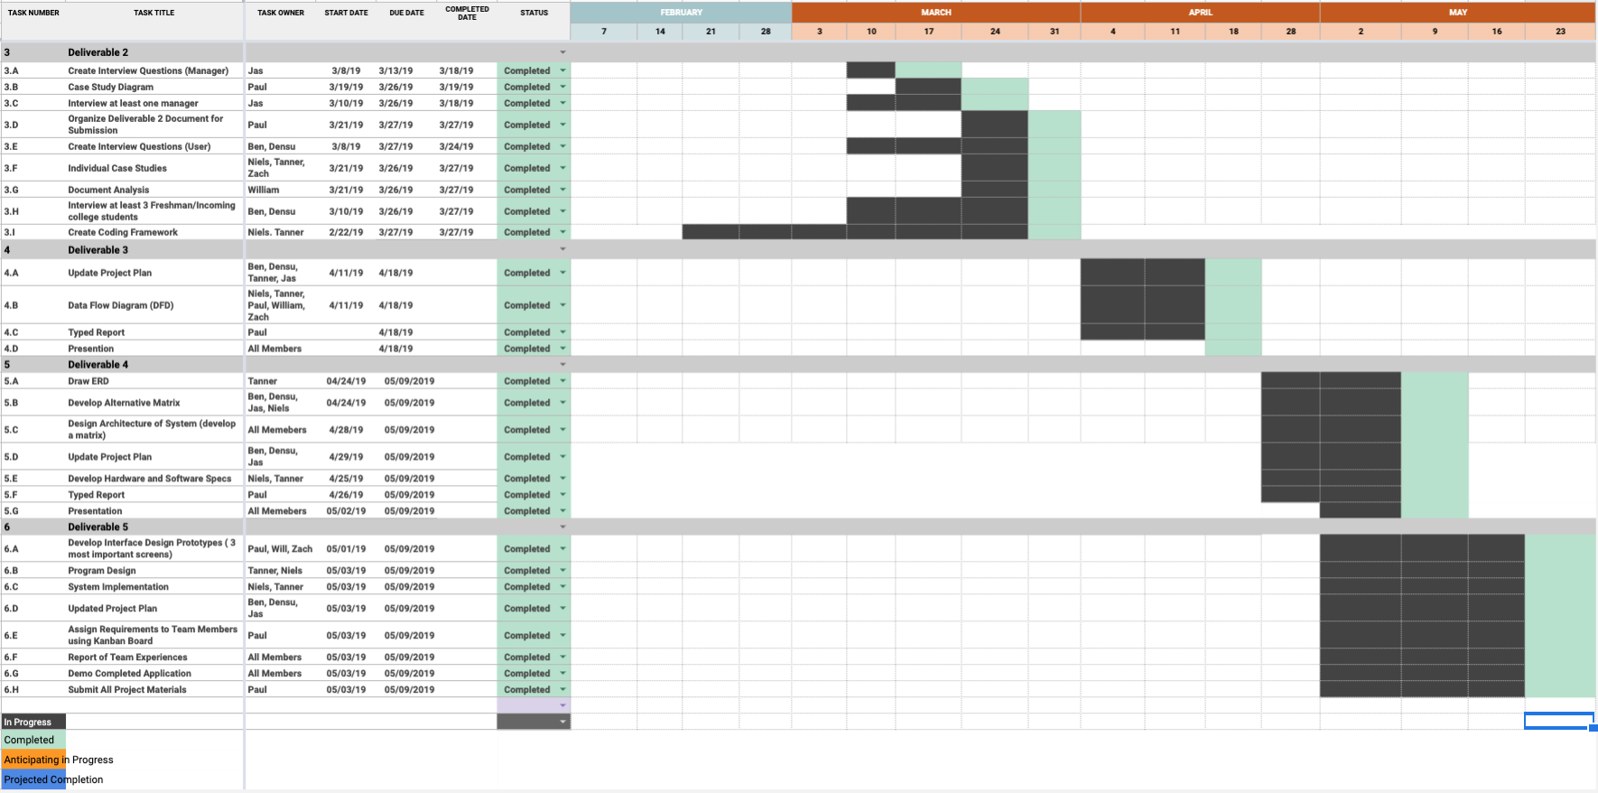
Updated - Project Plan

Slide 9
Kanban Flow - Link
https://kanbanflow.com/board/sPos7f

Slide 10
Team Experience

Slide 11
Questions??

Slide 12
Demo
http://prod-env.mzmmzmveia.us-west-2.elasticbeanstalk.com/

Slide 13
THANK YOU!

